Slide 1
College class database
By: Broady Rivet

Slide 2
Problem statements
College Course organization is a complicated structure to work on as an advisor.
There are usually conflicts with different professors’ schedules and/or desire classes to teach.
These problems are a regular occurrence across all colleges for ever quarter and semester.
The database structure is very straight forward relatively speaking but given the amount of alterations that can occur, the complexity can quickly rise.

Slide 3
Application area – Universities
Targeted toward advising committees of colleges who seek an organized manner to deal with class scheduling for professors.
Keeps each professor’s classes consistent across each quarter/semester based on their other occupation schedules.
More convenient for administrative staff that makes the schedules than traditional manual inputs.

Slide 4
Need for application
During scheduling chaos arises and some classes end up without a professor and some professors become over booked and/or over worked compared to others.
Keeps track of each professors' current openings.
Assigns class to a qualified professor who has an opening and removes the newly occupied opening.
Provides administration a more efficient way of scheduling classes.

Slide 5
Need for database
A database system helps track professor openings and qualifications
Allows administration to have a more efficient, accurate, and cleaner view of professor availabilities and qualifications; as well as class vacancies.
Allows for a more efficient and effective time when scheduling classes so the end product can get to and be seen by students.

Slide 6
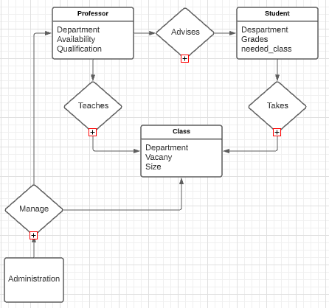
Er model

Slide 7
ENtities
Professor(Department, Availability, Qualifications)
Student(department, Grades, needed_class)
Class(department, vacancy, classroom_size)
Administration

Slide 8
Relationship
Advise(Teacher, student)
Teaches(Professor, class)
Takes(Student, class)
Manages(administration, professor, class)

Slide 9
Constraints
Professors can have multiple classes. However, they must be in the same subject.
Classroom size must not be filled for student to be allowed access.
Every class gets one professor

Slide 10
Timeline
Planning | Collect Data | Create commands | Make User-Interface
½ weeks | ½ weeks | 1 week | 2 weeks

